Slide 1
Web browsers

Slide 2
What are web browsers?
A web browser is a software program that allows a user to locate, access, and display web pages. In common usage, a web browser is usually shortened to "browser.“ Web browsers are used primarily for displaying and accessing websites on the internet, as well as other content created using languages such as Hypertext Markup Language (HTML) and Extensible Markup Language (XML).
Browsers translate web pages and websites delivered using Hypertext Transfer Protocol (HTTP) into human-readable content. They also have the ability to display other protocols and prefixes, such as secure HTTP (HTTPS), File Transfer Protocol (FTP), email handling (mailto:), and files (file:).

Slide 3
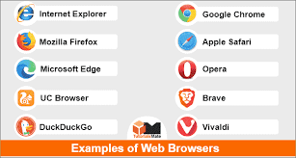
Examples of web browsers

Slide 4
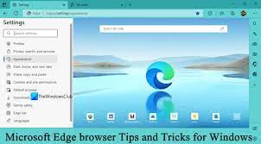
Microsoft edge browser

Slide 5
Why is edge browser the best?
Edge brings unique capabilities to your browsing, including enhanced security, money-saving shopping tools, excellent tab management features, and more. Edge offers clear privacy options. As with most choices in life, there’s a trade-off; The more secure and private the privacy level you choose, the fewer site features and less functionality you get. Strict tracking prevention in InPrivate windows is another good option, since you likely don’t want cross-site tracking happening during private browsing sessions. Microsoft Edge is a great native browser for Windows and a good alternative to Safari on macOS if you need a browser that runs outside Apple’s ecosystem.

Slide 6
Features and availability
• Stacks tabs vertically
• Groups websites into Collections
• Supports Dolby Audio and 4K
• Competes with Chrome in speed on Windows
Desktop: Windows, macOS
Mobile: iOS, iPadOS, Android

Slide 7
WORK Environments and browsers
Working in the doctor’s office, using Microsoft Edge browser will allow you to view and edit the patient’s data without leaving the browser.
Working in a Tech Company built into Microsoft Edge, Microsoft Defender SmartScreen blocks more phishing and malware attempts than Google Chrome's Safe Browsing, according to an independent test from CyberRatings.org. Microsoft Defender SmartScreen provides real-time reputation checks of sites and downloads as users work online, and is part of the Microsoft Intelligent Security Graph, which draws signals and insights generated from Microsoft's large network of global assets, researchers, and partners.
Working in an Accounting Firm Edge browser organize your browsing data—collect links, files, and more for easy access later.

Slide 8
Edge browser
ADVANTAGES
DISADVANTAGES
Synchronizes across devices.
Includes a PDF viewer.
Its helpfully customizable home page, speed, Collections feature, built-in screenshot tool, stackable tabs, support are just a few of the browser’s appealing features.
Page markup and sharing.
Not usable with older hardware specifications.
Other browsers have better performance.
Small number of sites don’t work.
Uses much less extensions.

Slide 9
How secure is it?
Microsoft Edge is built on top of the Chromium open source project—the same project that is core to Google Chrome—meaning it shares the same well-engineered and well-tested security architecture and design at its foundation. The Microsoft Edge security story doesn't stop there. In fact, Microsoft Edge is more secure than Google Chrome for your business on Windows. It has powerful, built-in defenses against phishing and malware and natively supports hardware isolation on Windows—there's no additional software required to achieve this secure baseline. Furthermore, when paired with native support for Microsoft 365 security and compliance services, Microsoft Edge brings additional, powerful security capabilities and features that help protect against data loss for even more benefits.
For more information:
https://learn.microsoft.com/en-us/deployedge/microsoft-edge-video-security-compatibility-manageability

Slide 10
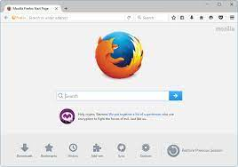
Mozilla Firefox browser

Slide 11
Why is Mozilla Firefox browser the best?
Which is the best web browser to use? Mozilla Firefox.
1. Why is it the best? Firefox supports your right to control how and with whom you share your personal data. Firefox only gathers the least amount of data and never sells it. They solely use the scant information they do gather to improve their products and features. No secrets. A lot of openness, transparency, and true privacy.
Support evidence - 1. Firefox is compatible with venerable OSes. In January 2022, Chrome stopped supporting Windows 7.
2. Firefox is more efficient and uses less memory than Chrome. When tested with 10 tabs open, Firefox occupied about 960MBs of memory, which is only slightly less than Chrome having 10 tabs open will cost your RAM just a bit shy of 1000MBs.

Slide 12
WORK Environments and browsers
For tech companies, Firefox being open source means the option exists for them to manipulate and make changes and additions to the browser based on their own specifications.
For businesses that buy systems in bulk, using Firefox to circumvent low level/older systems is often a work around to combat slower browsing speeds that may arise from using Chrome.
Since Firefox uses less memory and can manipulate multiple tabs and processes all at once, it can be more efficient in these cases like a call center. Many systems in a call center are on the lower end and suffer speed drops because of Chrome's intense memory requirements. However using browsers like Edge and Firefox avoids that.

Slide 13
Advantages of Mozilla Firefox
Since Firefox uses less memory, lower end systems have less trouble running the browser and can retain speed and processing power while opening and navigating between multiple tabs and web applications by choosing this browser over others like Chrome and Safari.
Mozilla takes advantage of several security features that make its base security stronger than other browsers. Such features include: Enhanced Tracking Protection, Site Information Panel, Content Blocking privacy features and Lockwise Anti-Snooping Feature.
Tabbed browsing and other advanced features — Tabbed browsing allows the user to open an unlimited number of pages in a single window, thus helping to organize browsing. Firefox also has an embedded memory, which means if the computer is turned off by mistake, the browser will remember which sites were open and offer to restore the previous session.

Slide 14
disadvantages of Mozilla Firefox
How would you feel if you were to download a huge file and it gets interrupted due to technical glitches? Well, there's a severe problem that, regrettably, plagues the Mozilla Firefox web browser. It means a download cannot be resumed if once interrupted. People are facing various problems due to this.
In comparison, Mozilla Firefox takes a while to load a web page. The numerous add-ons slow down the browser and reduce browsing performance.
According to complaints, some well-known websites with a commercial focus just don't appear correctly in this web browser. In addition, the browser uses more memory to function effectively, which ultimately degrades system speed.

Slide 15
How secure is it?
Firefox is a safe bet if you're looking for a private web browser. With higher extension compatibility and ease of use, Firefox is the best private browser option among widely used browsers when privacy settings are significantly modified and a few security add-ons are installed.

Slide 16
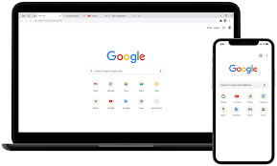
Google chrome browser

Slide 17
Why is google chrome the best?
In the early 2010s, the Google Chrome browser replaced more traditional browsers such as Internet Explorer and Mozilla Firefox as the industry standard and currently dominates the online browser market. Google Chrome is quick and simple to use and has the biggest collection of browser add-ons. Chrome is designed to be the fastest browser. It is considered the best browser due to these Features:
1. Fast browsing
2. Data server
3. Lets you download to view offline
4. Keeps your phone safe by showing warnings when you attempt to navigate through a dangerous site
5. Voice search option
6. Sync across devices

Slide 18
WORK Environments and browsers
Scenario 1: A doctor’s office that logs patients info electronically, researches prescribed medications for patients. Which browser would you recommend?
Google chrome for faster speed reducing wait time for patient with one click it loads web pages, multiple tabs and applications with lighting speed.
Scenario 2: A Call center, dealing with sensitive information such as credit card information, customer’s address etc.
As it relates to the securing of information Google chrome would be ideal as it periodically upgrades the chrome browser to keep secure. It also lets you browse and navigate the net while using less data just by turning on chrome’s data server this means conserving o data hence less spending for the company as it relates to data. We also want to eliminate wait time on the phone with customers. For those persons who would’ve had call center experience we know how it goes when we have to be switching from tabs to tabs so chrome is recommended for faster speed multiple tabs and applications. It is therefore best for people who want trouble-free, easy, and fast internet surfing.

Slide 19
Scenario 3: Working as a Procurement Specialist who obtains goods and services for business purposes.
Browser extensions that are available on Chrome, some may contain coupons searching software to get discount on the items which are being purchased and it also contains product scanners that scan the web for cheaper options.

Slide 20
Google chrome browser
ADVANTAGES
DISADVANTAGES
Chrome Browser has a basic user interface with mostly used buttons like forward , backward , refresh etc, it is therefore best for persons who are not so tech savvy. In a nutshell Google chrome is simple and easy to use. (SIMPLICITY)
Security/Privacy chrome keeps you safe and sound with its built in malware and phishing protection. It has safe browsing technology and will show you a warning message before you visit a site that is suspicious.
Most accurate result- Even though we tend to say Google is not always correct
Chrome does not have a sync option on Google. Other browsers, such as Mozilla Firefox, can sync with the Mozilla weave option on many computers. This feature helps you to merge your home browser, office browser history desktop, and preferences.
No customization and options as are available on the chrome browser. for example, if the chrome browser window is closed with several open tabs, you won’t be asked if you are closing or not all tabs. both tabs and windows are locked right away.

Slide 21
How secure is it?
Chrome is secure by default meaning (the default configuration settings are the most secure setting possible which are not necessarily the most user friendly settings), protecting you from dangerous and deceptive sites that might steal your passwords or infect your computer. Advanced technologies such as site isolation and sand boxing and predictive phishing protections keep you and your data safe.
Site isolation offers an extra line of defense to make such attacks less likely to succeed.
Sand boxing is a cyber security practice where you run code, observe and analyze and code in a safe, isolated environment on a network that mimics end user operating system.
Sandboxing is designed to prevent threats from getting on the network and is frequently used to prevent untested and untrusted code.

Slide 22
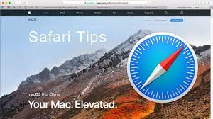
Safari browser

Slide 23
Why is safari the best?
The interface of Safari might seem bare-boned, which some users appreciate. Furthermore, one of its selling points is security and privacy. Like most of its competitors, Safari offers Private Browsing.
For security, it runs websites in a sandbox, meaning devices won’t get compromised by malicious scripts. It also has an Intelligent Tracking Prevention feature, which minimizes users’ tracking.
Private Relay. Performance and power efficiency, all the other browsers are increasingly more and more power inefficient: while Safari ensures that it is power efficient. Often times they are the main thing we use on our machines. Nice way to read pages without ads and other distractions, or in dark mode when they don’t support it.

Slide 24
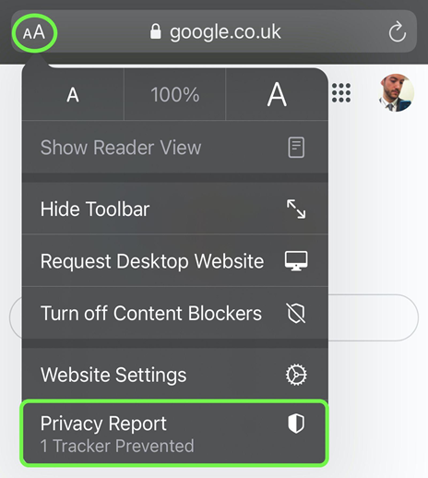
WORK Environments and browsers
Streamers:
Safari supports in-browser 4K HDR video playback for all online streaming. It also operates effectively to preserve battery life. You can view your favorite movies and television shows in their greatest light.
Privacy:
Safari makes it simple for a cybersecurity expert to understand how your privacy is protected on all the websites you visit. To view a list of cross-site trackers that are currently prevented from profiling you on the website you're visiting, click the Privacy Report button in your toolbar. To see how Safari protects you over time as you browse, you can also view a weekly privacy report.

Slide 25
Designed for developers:
Deep WebKit integration between Mac hardware and macOS allows Safari to give the quickest performance and the longest battery life of any browser on the platform, while supporting modern web standards for rich experiences in the browser. WebKit has been improved in macOS Ventura so that surfing experiences are considerably richer. This improvement also gives developers greater flexibility over styling and layout, enabling the creation of more engaging content.

Slide 26
Advantages of safari browser
Fast loading of html and css which in turs allows for a fast loading of any website.
It syncs your bookmarks tabs history and other information to iCloud so they are available on all your devices .
Safari comes with industry-leading privacy protection technology built in, including Intelligent Tracking Prevention that identifies trackers and helps prevent them from profiling or following you across the web.
It has an easy standardized user interface, but also allows for the user to customize the interface to there desire.
Safari also offers a strong password suggestion when you sign up for a new account on any website. And if you’re invested in the iCloud ecosystem, it syncs that password securely with your other devices, so you never actually have to remember it.

Slide 27
Disadvantages of safari browser
Limited compatibility. Safari is strictly available on Apple products. Thus, if you use Windows or Android, this browser is unavailable.
Issues with privacy-oriented features. Some features within the Safari browser might not be as private as assumed. For instance, Intelligent Tracking Prevention has had issues with doing its part of stopping cross-site tracking.
Lack of plugins. Safari does support some extensions available through the App Store. However, their number is much more humble, meaning users cannot extend browsers’ functionality however they like.
Closed-source code. The advantage of open-source browsers is that users can edit their code based on individual needs. Furthermore, open-source code also facilitates programmers outside the company to find errors or exploits.
Broken websites. Unfortunately, some websites get broken on Safari. It is because Safari uses Web Kit, which is less popular than the chromium engine. Therefore, more websites are likely to adjust to the latter.

Slide 28
How secure is it?
Safari has several security features, including security indicators and malware protection. It also uses Google safe browsing database to protect its user from phishing and malware. It should also be noted that safari is protected by a 128 bit encryption. The Safari browser features a VPN-like feature, sending traffic through multiple relays. It prevents ISPs and even Apple from seeing what you do online. However, this Private Relay is only available to iCloud+ subscribers.

Slide 29
The end

